Slide 1
COLLECTIVE BARGAIN AGENT FUNCTIONS
LAW207 | LABOUR LAW
Submitted by | Submitted to
NISHAT TASNIM ALVI 2311014 B Group | Department of Law & HR | ADV. NOYON ISLAM Lecturer Department of LAW & HR

Slide 2
INTRODUCTION OF CBA
CBA: Collective Bargaining Agent
A process where the representatives of a labor organization and business organizations meet and attempt to negotiate an agreement or contract contains the nature of the employee-employer union relationship

Slide 3
POWERS AND FUNCTIONS OF CBA
Formation of CBA | Functions of CBA
Union recognition Collective bargaining process Agreement and rectification Registration (For some Process) | Bargaining with employer Representation of workers Declaration of strike Nominating the representative Conducting cases
Powers and Contents of CBA | Wages and benefits Working hours and conditions Disciplinary Process Union Rights and security Employment terms Duration Binding effect

Slide 4
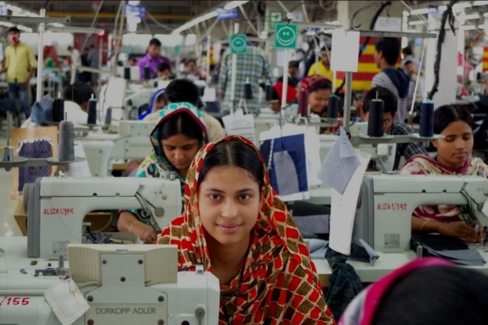
Img : Female Garment Workers working in a factory

Slide 5
PARTICIPATION OF THE COMMITTEE
Unique creation of Sec 205, Bangladesh Labor Act 2006, performs functions of a trade union
Establishment of a participation committee
Constitution of the committee
Number of representatives
Election of representatives
Activities of trade union
Unit participation committee
Obligations of the employer
Functions of the participation committee
Meetings of participation committee
Implementation and recommendation of participation committee

Slide 6
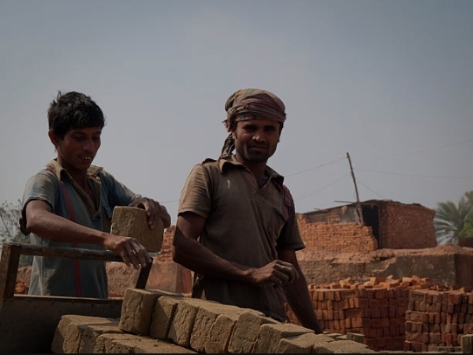
Img : Two brick labors are in a brickfield

Slide 7

Img : A group of people are protesting

Slide 8
CONCLUSION
The successful implementation of a collective branding agreement (CBA) is frequently dependent on the active and transparent engagement of the representative committee.
The committee, which is normally made up of representatives from the board of labor and management, plays an important role in negotiating equitable and sustainable conditions. Their engagement ensures that multiple perspectives are explored, resulting in agreements that respect the interests of all stakeholders. Effective involvement develops trust, promotes industrial harmony, and contributes to the long-term enforcement and interpretation of the CBA.

Slide 9


